Slide 1

Group Dynamics
Cdr Vijay Pratap Singh, Adjunct Professor
E&TC Dept, TCET

Slide 2
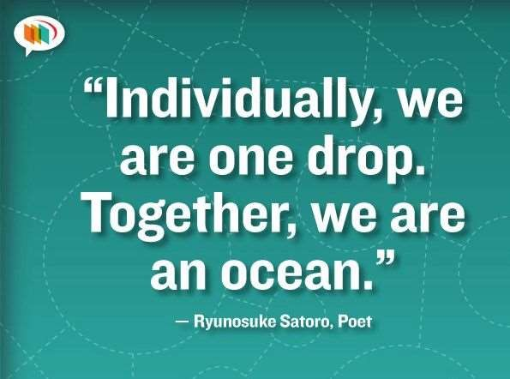

Slide 3

“Never doubt that a small group of thoughtful citizens can change the world. Indeed, it is the only thing
that ever has.”
Margaret Mead

Slide 4

GROUP
A group can be defined as several individuals who come together to accomplish a particular task or goal.

Slide 5

GROUP DYNAMICS
Group dynamics refers to the attitudinal and behavioural characteristics of a group.
The social process by which people interact in a group environment.
The influences of personality, power and behavior on the group process.

Slide 6
Group dynamics …
Group dynamics concern how groups form, their structure and process, and how they function.
Group dynamics are relevant in both formal and informal groups of all types.

Slide 7
Why it is important in organization ?
In an organizational setting, groups are very common
The study of groups and group dynamics is an important area of study in organizational behaviour.

Slide 8
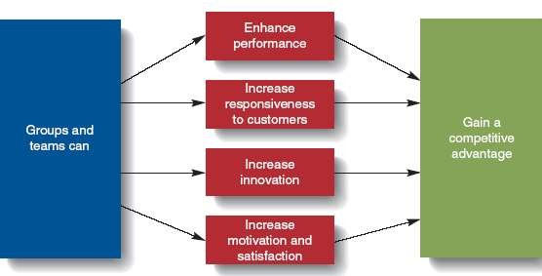

Slide 9
IMPORTANCE OF GROUP IN ORGANISATION
Groups typically outperform individuals when the tasks involved require a variety of skills, experience, and decision making.
Groups are often more flexible and can quickly assemble, achieve goals, and disband or move on to another set of objectives.

Slide 10
Importance of Group in organization…
Groups have many motivational aspects
Group members are more likely to participate in decision-making and problem-solving activities leading to empowerment and increased productivity.

Slide 11
IMPORTANCE OF GROUP IN ORGANIZATION …
Groups complete most of the work in an organization
Thus , the effectiveness of the organization is limited by the effectiveness of its groups.

Slide 12

Group development
As applied to group development, group
dynamics is concerned with why and how
groups develop.

Slide 13

GROUP DEVELOPMENT
WHY ?
Theories
Classic Theory
Social Exchange Theory
Social Identity Theory

Slide 14
Classic Theory
Developed by George Homans
Suggests that groups develop based on activities, interactions, and sentiments.
The theory means that when individuals share common activities, they will have more interaction and will develop attitudes (positive or negative) toward each other.
The major element in this theory is the
interaction of the individuals involved.

Slide 15
SOCIAL EXCHANGE THEORY
Individuals form relationships based on the implicit expectation of mutually beneficial exchanges based on trust and felt obligation.
Thus, a perception that exchange relationships will be positive is essential if individuals are to be attracted to and affiliate with a group.

Slide 16

SOCIAL IDENTITY THEORY
This theory suggests that individuals get a sense of identity and self-esteem based upon their membership in salient groups.
The nature of the group may be demographically based, culturally based, or organizationally based.

Slide 17
Social Identity Theory….
Individuals are motivated to belong to and contribute to identity groups because of the sense of belongingness and self-worth membership in the group imparts.

Slide 18


GROUP TYPES
Formal
Informal

Slide 19
FORMAL GROUPS
Established by an organization to achieve organizational goals.
May take the form of
Command groups
Task groups
Functional groups.

Slide 20
COMMAND GROUPS
Are specified by the organizational chart and often consist of a supervisor and the subordinates that report to that supervisor.
An example of a command group is an academic department chairman and the faculty members in that department.

Slide 21
TASK GROUPS
Consist of people who work together to achieve a common task.
Members are brought together to accomplish a narrow range of goals within a specified time period.

Slide 22
FUNCTIONAL GROUP
Created by the organization to accomplish specific goals within an unspecified time frame.
They remain in existence after achievement of current goals and objectives.
Example : a marketing department

Slide 23
INFORMAL GROUPS …
They are created for purposes other than the accomplishment of organizational goals and do not have a specified time frame.
Informal groups can have a strong influence in organizations that can either be positive or negative.

Slide 24

INFORMAL GROUPS
Unofficial or emergent groups that evolve in the work setting to gratify a variety of member needs not met by formal groups.

Slide 25
INFORMAL GROUPS …
Types
Interest group
Friendship group
Reference group

Slide 26
INTEREST GROUPS
Usually continue over time and may last longer than general informal groups.
Members of interest groups may not be part of the same organizational department but they are bound together by some other common interest.
The goals and objectives of group interests are specific to each group and may not be related to organizational goals and objectives.

Slide 27
FRIENDSHIP GROUPS
Are formed by members who enjoy similar social activities, political beliefs, religious values, or other common bonds.
Members enjoy each other's company and often meet after work to participate in these activities.

Slide 28
REFERENCE GROUP
A type of group that people use to evaluate themselves.
According to Cherrington, the main purposes of reference groups are social validation and social comparison.
Social validation allows individuals to justify their attitudes and values while social comparison helps individuals evaluate their own actions by comparing themselves to others.

Slide 29
REFERENCE GROUP…
Reference groups have a strong influence on members' behaviour.
By comparing themselves with other members, individuals are able to assess whether their behaviour is acceptable and whether their attitudes and values are right or wrong.

Slide 30

GROUP DEVELOPMENT
“HOW”?
by Bruce Tuckman in the 1960s.

Slide 31
FIVE STAGES
Forming
Group members get to know each other and reach common goals.
Storming
Group members disagree on direction and leadership.
Managers need to be sure the conflict stays focused.
Norming
Close ties and consensus begin to develop between group members.

Slide 32
FIVE STAGES
Performing
The group begins to do its real work.
Adjourning
Only for task forces that are temporary.

Slide 33



PHYSICAL CONDITIONS THAT INFLUENCE GROUP DYNAMICS
Seating
Size
Membership

Slide 34
GROUP STRUCTURE
Group structure is a pattern of relationships
among members that hold the group together and help it achieve assigned goals.

Slide 35
GROUP STRUCTURE…
Structure can be described in terms of
Group Size
Group Roles
Group Norms
Group Cohesiveness.

Slide 36

GROUP SIZE
Group size can vary from 2 people to a very large number of people.
Small groups of two to ten are thought to be more effective because each member has ample opportunity to participate and become actively involved in the group.

Slide 37

Large groups may waste time by deciding on processes and trying to decide who should participate next.
Group size will affect not only participation but satisfaction as well.

Slide 38

GROUP SIZE…
Evidence supports the notion that as the size of the group increases, satisfaction increases up to a certain point.
In other words, a group of six members has twice as many opportunities for interaction and participation as a group of three people.

Slide 39
GROUP SIZE…
Beyond 10 or 12 members, increasing the size of the group results in decreased satisfaction.
It is increasingly difficult for members of large groups to identify with one another and experience cohesion.

Slide 40

GROUP ROLES
In formal groups, roles are usually predetermined and assigned to members.
Each role will have specific responsibilities and duties.
There are emergent roles also that develop naturally to meet the needs of the groups.

Slide 41
GROUP ROLES
These emergent roles will often replace the assigned roles as individuals begin to express themselves and become more assertive.
The main types of roles are
Work role
Maintenance role
Blocking roles

Slide 42
WORK ROLES
Work roles are task-oriented activities that involve accomplishing the group's goals.
They involve a variety of specific roles such as
The initiator :defines problems, proposes action, and suggests procedures.

Slide 43
The informer : finds out the facts and give advice or opinions.
Clarifier :will interpret ideas, define terms, and clarify issues for the group.
Summarizers : restate suggestions, offer decisions, and come to conclusions for the group.
Reality testers :analyze ideas and test the ideas in real situations.

Slide 44
MAINTENANCE ROLE
Social-emotional activities that help members maintain their involvement in the group and raise their personal commitment to the group.
The maintenance roles are
Harmonizer will reduce tension in the group, reconcile differences, and explore opportunities.

Slide 45
Gatekeepers often keep communication channels open and make suggestions that encourage participation.
Consensus tester will ask if the group is nearing a decision and test possible conclusions.
Encouragers are friendly, warm, and responsive to other group members.
Compromiser: this involves modifying decisions, offering compromises, and admitting errors.

Slide 46
BLOCKING ROLES
are activities that disrupt the group.
Blockers will stubbornly resist the group's ideas, disagree with group members for personal reasons, and will have hidden agendas.

Slide 47
BLOCKING ROLES…
The dominator role attempts to control conversations by patronizing others.
They often interrupt others and assert authority in order to manipulate members.

Slide 48
BLOCKING ROLES…
Comedians often abandon the group even though they may physically still be a part.
They are attention-getters in ways that are not relevant to the accomplishment of the group's objectives.

Slide 49
BLOCKING ROLES…
Avoidance behaviour, involves pursuing goals not related to the group and changing the subject to avoid commitment to the group.

Slide 50
ROLE AMBIGUITY
It concerns the discrepancy between the sent role and the received role.
Supervisors, directors, or other group leaders often send (assign) roles to group members in formal groups.
Group members receive roles by being ready and willing to undertake the tasks associated with that role.

Slide 51
ROLE AMBIGUITY AND ROLE CONFLICT
Sender
Receiver
Role Expectations
Role
Sent
Role Received
Role Behavior
Role
Ambiguity
Role Conflict

Slide 52
ROLE AMBIGUITY
Ambiguity results when members are confused about the delegation of job responsibilities.
This confusion may occur because the members do not have specific job descriptions or because the instructions regarding the task were not clear.
Group members who experience ambiguity often have feelings of frustration and dissatisfaction, which ultimately lead to turnover.

Slide 53

ROLE CONFLICT
Occurs when there is inconsistency between the
perceived role and role behavior.
There are several different forms of role conflict.
Interrole conflict
Intrarole conflict

Slide 54
ROLE CONFLICT
Interrole conflict occurs when there is conflict between the different roles that people have.
For example, work roles and family roles often compete with one another and cause conflict.
Intrarole conflict occurs when individuals must handle conflicting demands from different sources while performing the tasks associated with the same role.

Slide 55

GROUP NORMS.
Norms are acceptable standards of behavior within a group that are shared by the members of the group.
Norms define the boundaries of acceptable and unacceptable behavior.

Slide 56
GROUP NORMS…
They are typically created in order to
facilitate group survival,
make behavior more predictable,
avoid embarrassing situations,
express the values of the group.

Slide 57
GROUP NORMS…
Each group will establish its own set of norms that might determine anything from the appropriate dress to how many comments to make in a meeting.
Groups exert pressure on members to force them to conform to the group's standards.

Slide 58
GROUP NORMS…
The norms often reflect the level of
commitment, motivation, and performance of the group.

Slide 59
PERFORMANCE NORMS
Determine how quickly members should work and how much they should produce.
They are created in an effort to determine levels of individual effort.

Slide 60
PERFORMANCE NORMS…
They can be very frustrating to managers because they are not always in line with the organization's goals.
Members of a group may have the skill and ability to perform at higher levels but they don't because of the group's performance norms.

Slide 61
REWARD-ALLOCATION NORMS
Determine how rewards are bestowed upon group members.
For example, the norm of equality dictates equal treatment of all members. Every member shares equally so rewards are distributed equally to everyone.

Slide 62
REWARD-ALLOCATION NORMS…
norm of equity
Suggest that rewards are distributed according to the member's contribution.
In other words, members who contribute the most receive the largest share of the rewards.
Members may contribute through effort, skill, or ability.

Slide 63
REWARD-ALLOCATION NORMS…
Social responsibility norms reward on the basis of need.
Members who have special needs therefore receive the largest share of the reward.

Slide 64
GROUP NORMS…
The majority of the group must agree that the norms are appropriate in order for the behavior to be accepted.
There must also be a shared understanding that the group supports the norms.

Slide 65
GROUP NORMS…
But the members might violate group norms from time to time.
If the majority of members do not adhere to the norms, then they will eventually change and will no longer serve as a standard for evaluating behavior.
Group members who do not conform to the norms will be punished by being excluded, ignored, or asked to leave the group.

Slide 66
GROUP COHESIVENESS.
Group Cohesion - interpersonal attraction binding group members together
Cohesiveness refers to the bonding of group members and their desire to remain part of the group.
Many factors influence the amount of group cohesiveness.
Generally speaking, the more difficult it is to obtain group membership the more cohesive the group.

Slide 67
FACTORS PROMOTING COHESIVENESS
Similarity of work
Physical proximity in the workplace
The work-flow system
Structure of tasks
Size of group (smaller rather than larger)
Threats from outside
The prospect of rewards
Leadership style of the manager
common social factors (age, race, social status etc.)

Slide 68


ADVANTAGES
Groups with high cohesiveness
Demonstrate lower tension & anxiety
Demonstrate less variation in productivity
Demonstrate better member satisfaction, commitment, & communication

Slide 69
ADVANTAGES
Worker satisfaction
Low turnover and absenteeism
Higher productivity
Enables groups to exercise effective control over the members.

Slide 70
DISADVANTAGES
Highly cohesive groups may be detrimental to organizational performance if their goals are misaligned with organizational goals.
Highly cohesive groups may also be more vulnerable to groupthink.

Slide 71
GROUPTHINK
Is defined as “the deterioration of mental efficiency, reality testing, and moral judgement in the interest of group solidarity.”

Slide 72
GROUPTHINK
occurs when members of a group exert pressure on each other to come to a consensus in decision making.
It results in
careless judgments
unrealistic appraisals of alternative courses of action
a lack of reality testing

Slide 73




It can lead to a number of decision- making issues such as the following:
Incomplete assessments of the problem
Incomplete information search
Bias in processing information
Inadequate development of alternatives
Failure to examine the risks of the preferred choice.

Slide 74
SOCIAL LOAFING
The failure of a group member to contribute personal time, effort, thoughts, or other resources to the group
The human tendency to put forth less effort in a group than individually.
Results in
lower group performance
failure to attain group goals

Slide 75
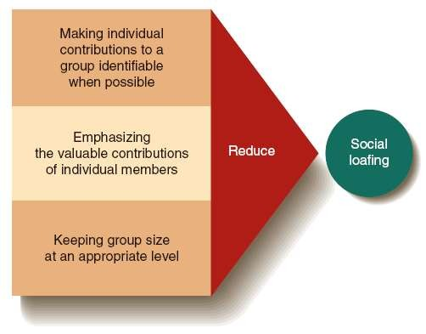

Slide 76
Factors Leading to Group Cohesiveness
Factor
Group Size | Smaller groups allow for high cohesiveness; Low cohesiveness groups with many members can benefit from splitting into two groups.
Managed Diversity | Diverse groups often come up with better solutions.
Group Identity | Encouraging a group to adopt a unique identity and engage in competition with others can increase cohesiveness.
Success | Cohesiveness increases with success; finding ways for a group to have some small successes increases cohesiveness.

Slide 77
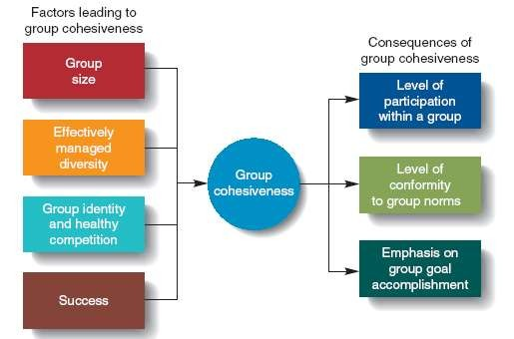

Slide 78
Group Behaviour
Group behaviour emanates from the causes that contribute to the group’s effectiveness .

Slide 79
Characteristics of a
Well-Functioning, Effective Group
Relaxed, comfortable, informal atmosphere
Task well understood & accepted
Members listen well & participate
People express feelings & ideas

Slide 80
Characteristics of a
Well-Functioning, Effective Group
Conflict & disagreement center around ideas or methods
Group aware of its operation & function
Consensus decision making
Clear assignments made & accepted

Slide 81
IN NURSING………………
Knowledge of group dynamics is needed by nurse managers to improve leadership competencies and facilitates group discussions and communication.

Slide 82
Nurses participate in group situations on a daily basis
In health care settings ,nurses serve on or lead task groups that create policy, describe procedures, and plan client care

Slide 83
CONCLUSION
The usefulness of groups is nowhere more apparent than when groups are used to help their members change.
Groups, by their very nature, provide their members with information, support, and guidance, and so many personal and interpersonal problems can be resolved more readily when confronted in a group rather than alone.

Slide 84
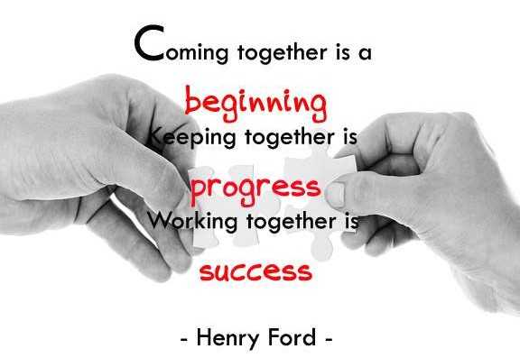

Slide 85
REFERENCES
Barge, J. K. (2002). Enlarging the meaning of groupdeliberation: From discussion to dialogue. IL.
R. Frey (Ed.), New directions in group communication.
Townsend.C Mary,Psychiatric Mental Health Nursing.

Slide 86



